Slide 1


Youtube songs Data Analysis
SAI PHANI KUMAR CHINTA
Batch – MIP-DA-10

Slide 2


Table of
CONTENTS
01
02
03
04
Agenda
Problem statement
Dataset Description
Project Objectives
05
06
07
08
Dashboard
Insights
Recommendations
Thanks

Slide 3
Agenda
1
2
3
To find the trends & patterns of popular songs
To build the interactive dashboard
To recommend creators for better performance

Slide 4

PROBLEM STATEMENT
This project aims to conduct a comprehensive analysis of YouTube songs data using Power BI.
The dataset contains key attributes such as video ID, channel title, title, description, tags, published date, view count, like count, favorite count, comment count, video duration, video definition, and caption details.
The goal is to utilize Power BI to create insightful visualizations and reports that provide a deeper understanding of YouTube songs' performance, popularity, and user engagement.
The analysis aims to uncover trends, preferences, and patterns in the data to aid content creators and stakeholders in optimizing their YouTube song content.

Slide 5
DATASET DESCRIPTION
1. video_id: Unique identifier for each YouTube video.
2. channelTitle: Title of the YouTube channel publishing the song.
3. title: Title of the YouTube song video.
4. description: Description provided for the YouTube song video.
5. tags: Tags associated with the YouTube song video.
6. publishedAt: Date and time when the YouTube song video was published.
7. viewCount: Number of views received by the YouTube song video.
8. likeCount: Number of likes received by the YouTube song video.
9. favoriteCount: Number of times the YouTube song video has been marked as a favorite.
10. commentCount: Number of comments posted on the YouTube song video.
11. duration: Duration of the YouTube song video.
12. definition: Video definition or quality (e.g., HD, SD).
13. caption: Availability of captions for the YouTube song video.

Slide 6
PROJECT OBJECTIVES
1. Data Cleaning and Preparation:
2. Exploratory Data Analysis (EDA):
3. Content and Channel Analysis:
4. Temporal Trends:
5. User Engagement Insights:
Clean and preprocess the dataset, handling missing values or outliers.
Convert relevant columns to appropriate data types.
Explore patterns and distributions in view counts, like counts, and comments.
Identify trends in the popularity and engagement of YouTube song videos.
Analyze the distribution of videos across different channels.
Identify popular tags and their correlation with view counts.
Explore how YouTube song video metrics vary over time.
Identify peak publishing times and their impact on engagement.
Investigate relationships between likes, comments, and views.
Identify factors influencing user engagement with YouTube song videos.

Slide 7

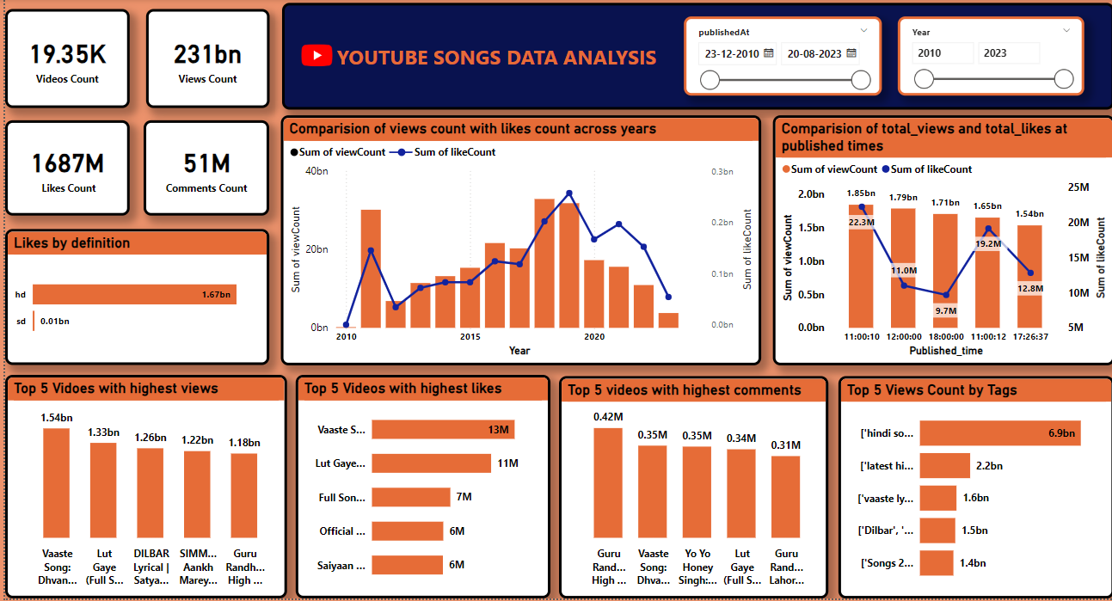
DASHBOARD

Slide 8
KEY INSIGHTS
The Total Number of Videos Uploaded are 19.35K
The total view count, like count & comment count is 231bn , 1687m & 51m respectively
Videos from 2011, 2018 & 2019 have got most views and videos from 2018, 2019 got more likes compared to others yars which indicates that videos from those years have got higher user Engagement
As per the trend, Users loved to watch HD content more compared to SD content. It has got substantial difference of 1.67bn and 0.01bn.

Slide 9
KEY INSIGHTS
Tags contains Hindi songs, 2021 Hindi songs, Film songs, Hindi movie songs, Bollywood new songs etc; has got more views and likes.
Videos which are released at day hours have got more user engagement especially at 11 Am reaped huge reach. Hence it is the peak publishing time to upload videos.
Vaaste song stood first & has got huge response in terms of views, likes and comments.

Slide 10
RECOMMENDATIONS
It is recommended to upload content at day hours especially around 11am to 12pm because user engagement is higher at that particular hour.
Users are inclined to watch High Definition content, Therefore making videos in HD would reap more reach in terms of engagement.
As views and likes, comments are directly proportional to each other. It is advised to focus to produce content which grabs audience then getting likes and commnets would be invetible.
While posting video its better to include tags like Hindi songs, 2021 Hindi songs, Film songs, Hindi movie songs, Bollywood new songs etc that reaches wider audiences.

Slide 11



THANKS
Saiphani.chinta@gmail.com

